Slide 1




Biodiversity measurements across metrics and scales
@jon_chase03
jonathan.chase@idiv.de

Slide 2
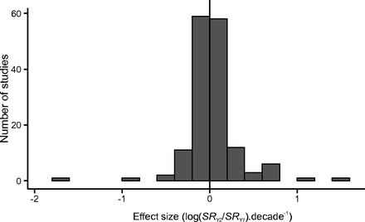
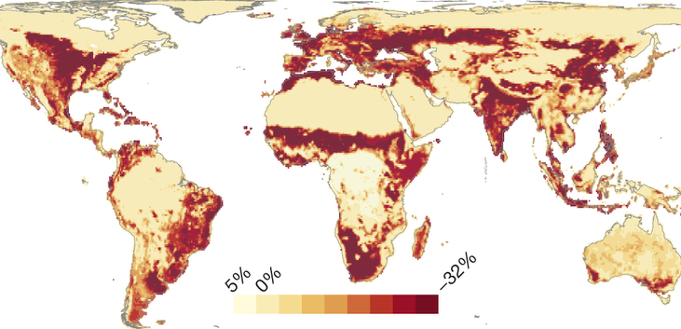
Is local diversity really declining?
Vellend et al. 2013
Newbold et al. 2015, Nature

Slide 3
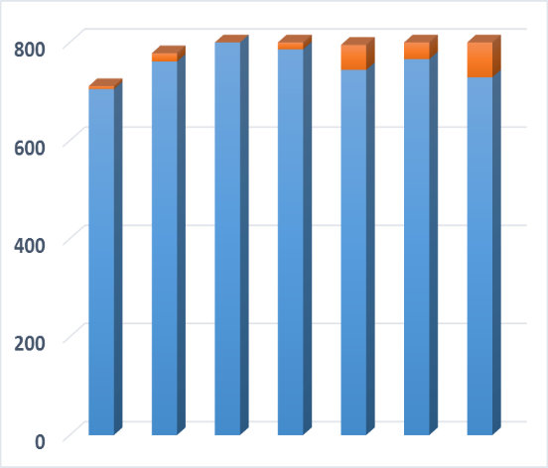
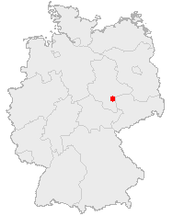
Towards synthesis…. Methods/approach matter
…As does scale
Number of Species
Public Domain, https://commons.wikimedia.org/w/index.php?curid=362363
~1700
1850
1950
~Today
Year
Data from: Knapp, S., et al. 2016. Journal of Applied Ecology
From the PREDICTS database
Newbold et al. 2015, Nature

Slide 4
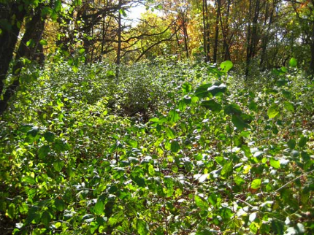
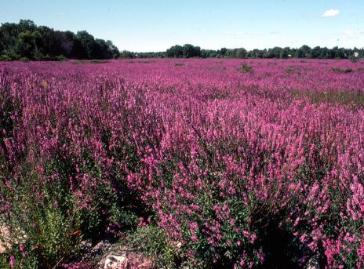
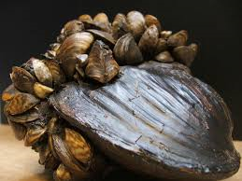
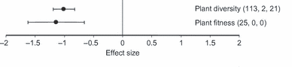
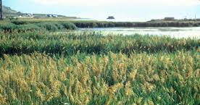
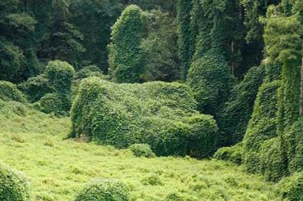
Alien species are the “second greatest threat” to biodiversity
Vila et al. 2011 Ecol. Letters
Murphy and Romanuk 2012, Am. Nat.

Slide 5


Slide 6
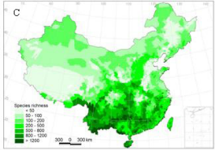
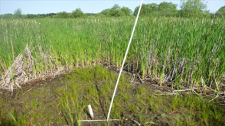
A Resolution? ……Spatial Scale
Experiments and meta-analyses
-Richness decreases
-Typically <<100 m²
-Richness → changes in relative abundance
Observations
-Little effect on richness
-Typically >>10,000 m²
-Richness → Local extirpation/extinction
Control=Invaded
Species Richness
Control
Invaded
Small
Spatial Scale
Large

Slide 7
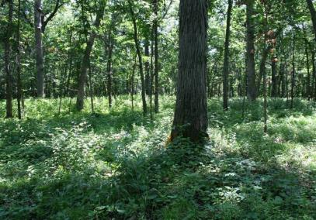
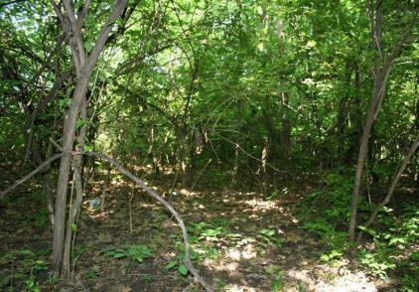
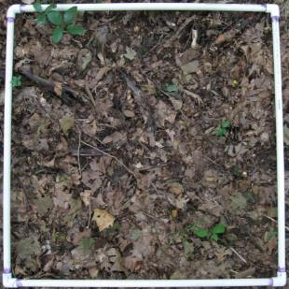
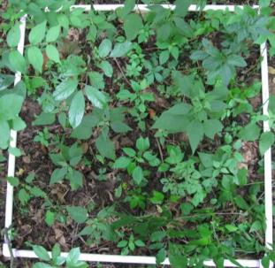
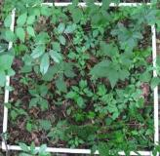

Scale-dependence of invasive species impacts
2.0
R²=0.995, P<0.001
R²=0.978, P=0.001
1.5
Log(Species Richness)
1.0
Uninvaded
Invaded
0.5
0
1
2
3
Log(Area)
Powell, Chase, Knight 2013. Science

Slide 8
A Neutral Sampling Effect
Degraded Community
Pristine Community
Small Effect
Large effect
10
Species Richness
8
6
4
2
0
0 30 60 90 120 150 180
Area Sampled
Chase and Knight 2013 Ecology Letters

Slide 9
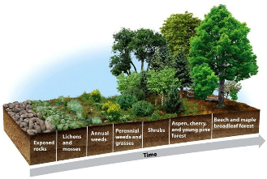
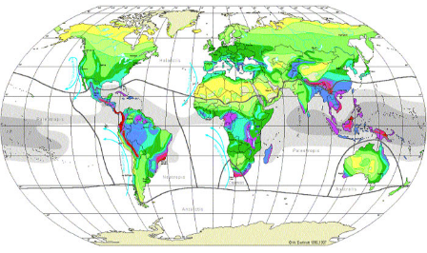
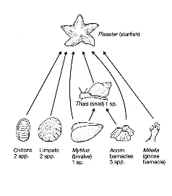
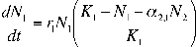
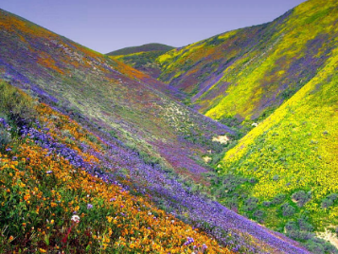
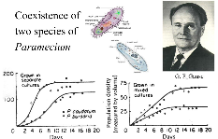
Process→Pattern
Pattern→Process

Slide 10
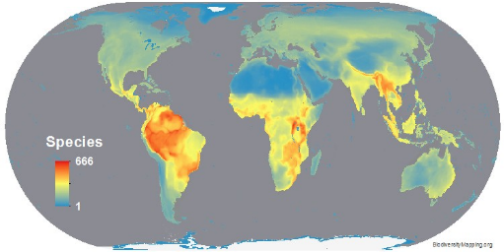
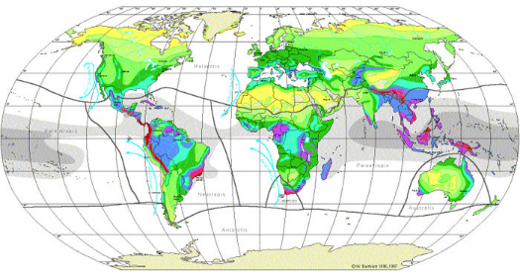
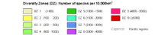
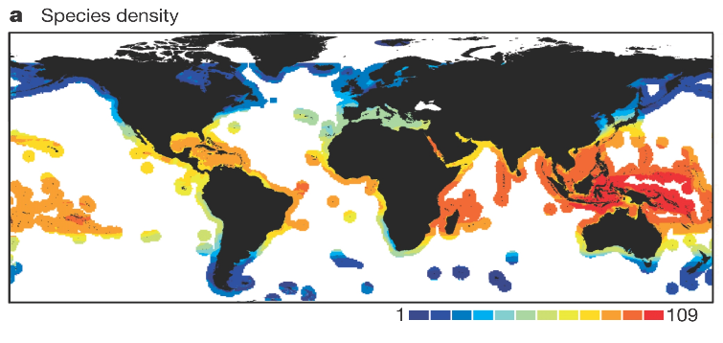
Bird Diversity
Vascular Plants
Marine Fishes

Slide 11
Major Ecological Gradients
Latitude
Elevation
Energy/Productivity
Heterogeneity
Disturbance
Island size/Habitat Loss
Biogeography, other factors

Slide 12
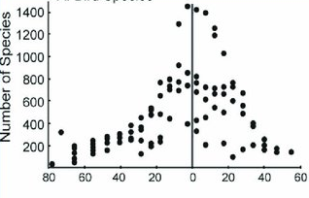
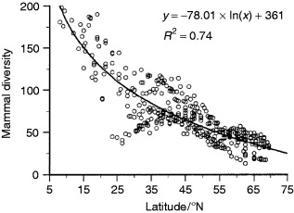
Latitude

Slide 13
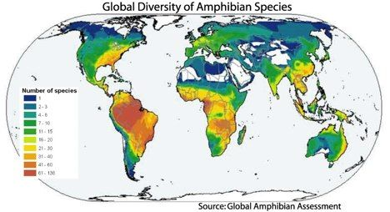
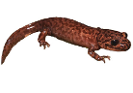
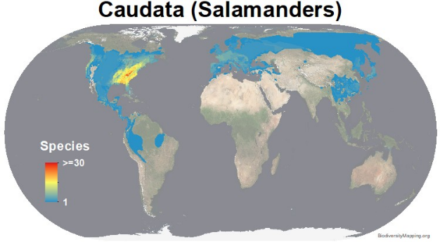
Taxonomic scale matters

Slide 14
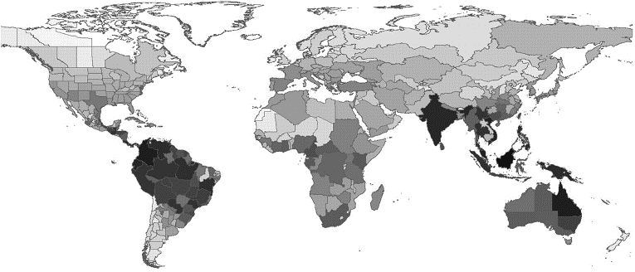
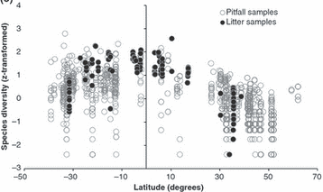
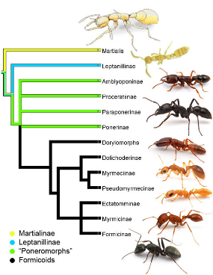
Biogeography matters
Dunn et al. 2009, Ecology Letters

Slide 15
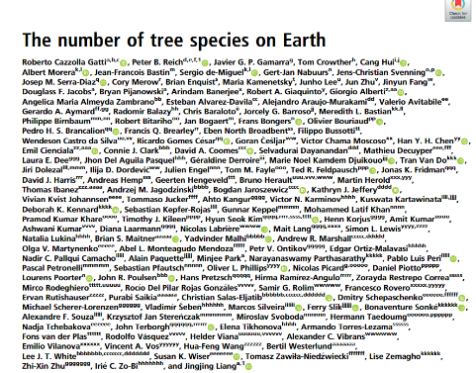

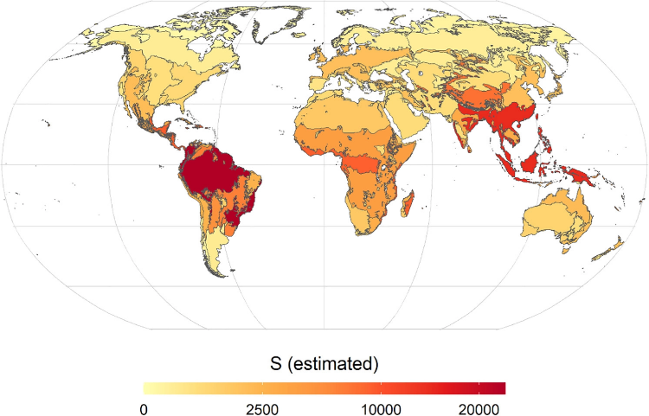
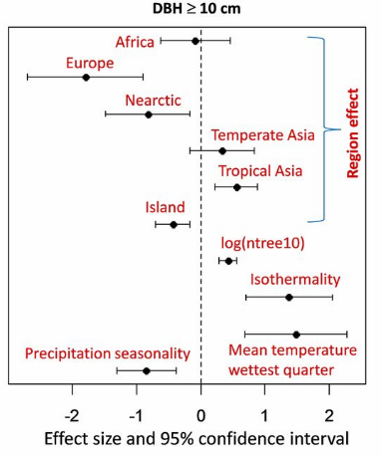

Slide 16

Measuring Species Richness

Slide 17
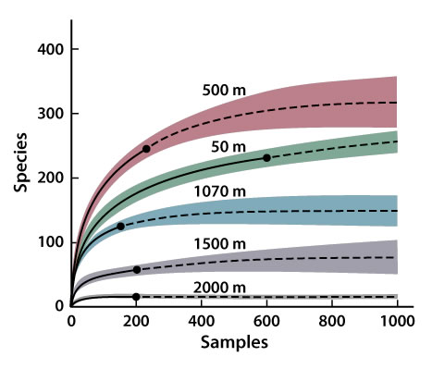
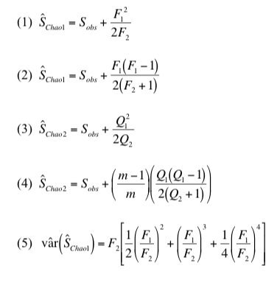
Species Richness Estimators: what is the ‘True’ species richness?
Work from Anne Chao and others

Slide 18
Assumption that there is an asymptote in species richness is invalid
Sampling extent
Number of species
Many solutions, all make improbable assumptions at some scale
Area, samples, or individuals

Slide 19
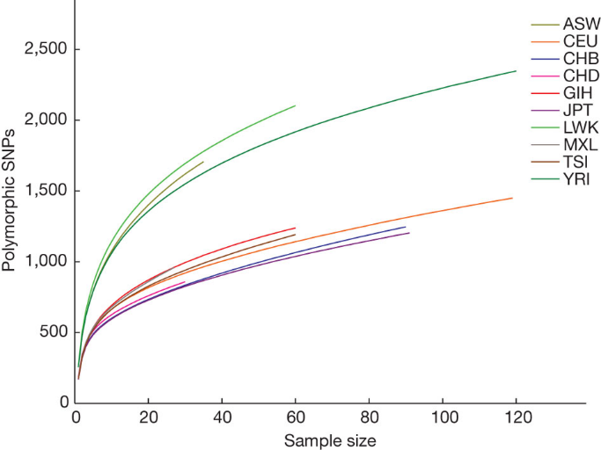
Same problems in genomics/genetics….

Slide 20
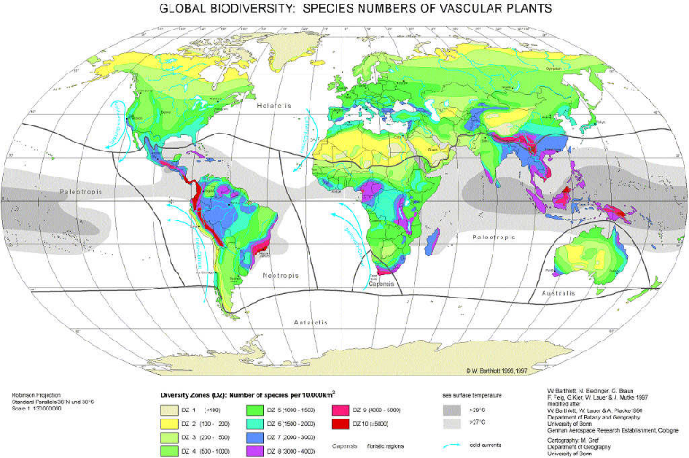
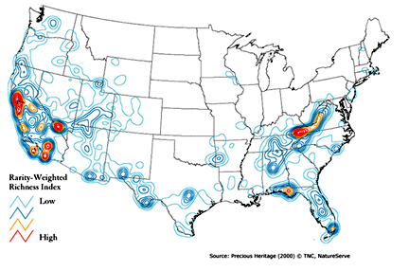
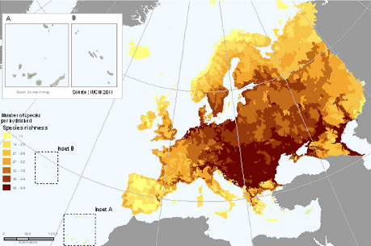
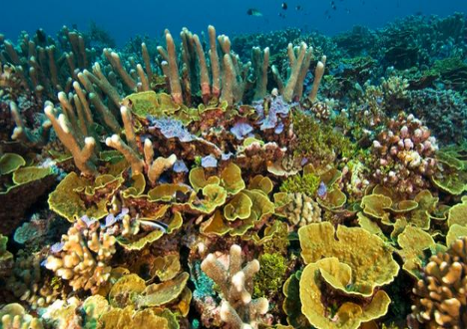

Slide 21
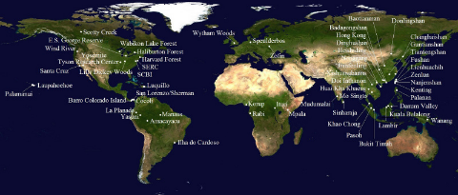
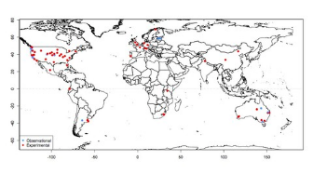
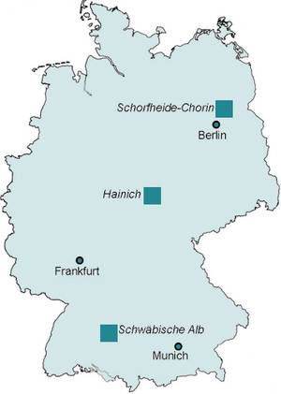
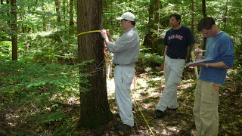
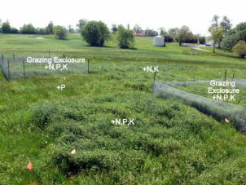

Aren’t consistent sampling schemes enough?
Unfortunately, no….
CTFS-SGIEO Forest Plots
NutNet Forest Plots

Slide 22


Slide 23


Scale-dependence is inevitable….
Species Richness
Sampling Effort
Species-Area Curve (many types)
Species Accumulation Curve
Rarefaction Curve

Slide 24






Biodiversity Scaling—

Slide 25
Different Kinds of Species Area Relationships (SARs)
Island Species Area Relationship (ISAR)
Scheiner 2003

Slide 26
Near Mainland
Far from Mainland
MacArthur and Wilson 1963

Slide 27
Different Kinds of Species Area Relationships (SARs)
Nested
Island Species Area Relationship (ISAR)
Scheiner 2003

Slide 28

Preston 1960

Slide 29
Mechanisms of the SAR
Sampling
Heterogeneity
Area ‘Per se’ (=metacommunity processes)
Connor and McCoy 1979

Slide 30
SAR principles can be used to predict extinctions

Slide 31

From MacArthur and Wilson 1967

Slide 32

Any measure of diversity only captures part of the picture
α, richness, evenness, diversity entropy
β, similarity, distance decay
γ, SAR, EAR, etc

Slide 33
Graham and Blake 2001

Slide 34




Can’t we just correct for area?
Number of species per area
Large island
Medium island
Number of Species
Small island
Area sampled

Slide 35
Solutions are not as easy as they might seem…
Extrapolations and interpolations are still strongly biased by sample grain/extent
Partitioning of scales (e.g., α-diversity, β-diversity, γ-diversity) doesn’t account for non-linearities
Explicit scaling exponents (e.g., species-accumulations, species-area relationships) are confounded by multiple factors

Slide 36


.. we already have a way to deal with scale…β-diversity
α β = γ
β = γ/α
γ-diversity (21)
10
3
α-diversity
4
11
= 21 / 7
= 3
5
9
α-diversity
β-diversity is a scalar from local (α) to regional (γ)

Slide 37
β-diversity is also complicated
γ-diversity
β-diversity
Diversity
α-diversity
Local Regional
Spatial Scale
Linearization of an inherently non-linear pattern
Shape determined by several distinct components that underlie SAC
Critically grain and extent dependent

Slide 38
Sample Grain and Extent drive β-diversity
Larger grain/extent
α-diversity
α-diversity
γ-diversity
γ-diversity
β
β
Number of Species
β
β
Area sampled

Slide 39
Sample problems in genomics/genetics….

Slide 40


Other kinds of diversity—Ethnic, Language, etc

Slide 41

Economics has been doing something similar for some time (Gini Coefficient)

Slide 42


Biodiversity across scales
Number of individuals
Species relative abundances
Spatial distribution
(e.g. aggregation)
Biodiversity drivers (Land use, climate, invaders, …)
package mobsim

Slide 43



package mobsim
https://github.com/MoBiodiv/mobsim

Slide 44






Slide 45



Slide 46


Slide 47

Steps:
Sample data from each locality (bag)
Sum data from each region (3 bags)
→enter into spreadsheet
3. Experimental predation (remove 50% of individuals randomly)
4. Repeat Step #1
5. Repeat Step #2
→enter into spreadsheet
6. Analyze/visualize
7. Discuss

